Slide 1

Project Synapse
Optimizing Last-Mile Delivery with AI-Powered Address Verification
The Problem & Our Solution
  Problem: Incorrect addresses cause delays, wasted fuel, and missed deadlines (SLAs). Current systems are rigid and can't adapt to real-time issues.
Solution: An LLM-powered autonomous agent that:
  Prevents incorrect addresses with crosscheck_address() at the time of order placement.
  Requests an alternate delivery location upfront (neighbor, office, or locker).
  Resolves real-time issues by contacting the customer or switching to a backup location.
  Integrates with delivery APIs for smart tool selection and reasoning.
Key Benefits: Fewer failed deliveries, less idle driver time, improved SLA compliance, and higher customer satisfaction.

Slide 2
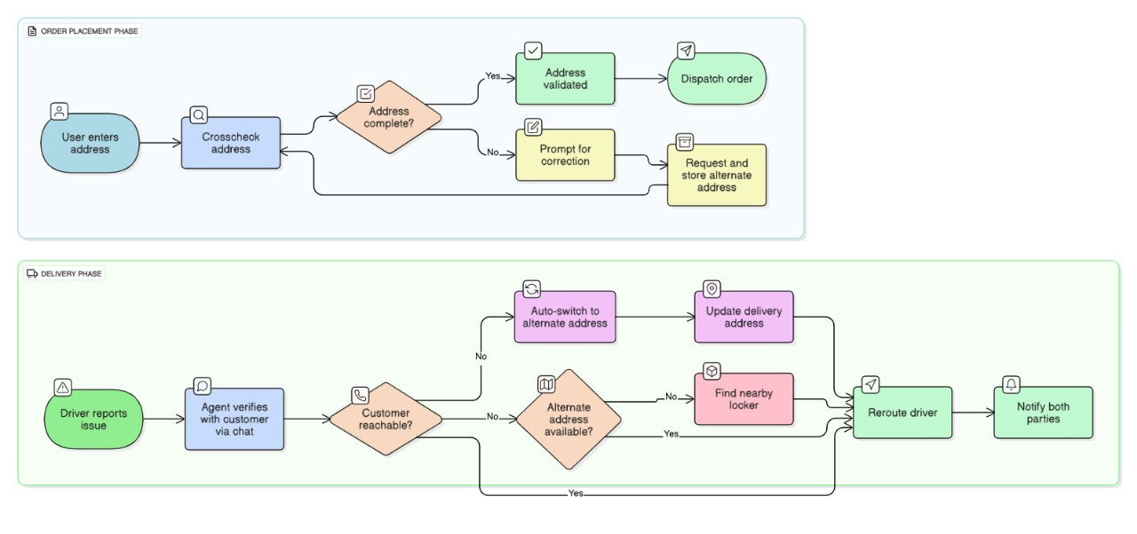
Workflow + System Architecture
1. Preventive Phase (Order Placement):
  Customer enters address → Agent runs crosscheck_address().
  If incomplete, it prompts for correction and requests an alternate address.
  Order is dispatched only after validation.
2. Corrective Phase (During Delivery):
  Driver reports issue → Agent verifies with contact_customer_via_chat().
  If the customer is unreachable, it auto-switches to the alternate address using update_delivery_address().
  If no alternate is available, it uses find_nearby_locker() to locate the nearest locker.
  The system then reroutes the driver and notifies both parties.

Slide 3
Smart Parcel Delivery Platform (Frontend Prototype)
🔹 Pages & UI Flow
    Home / Dashboard – Hero section, delivery options (Bike, Car, Van, Scheduled).
    Contact Us & About Us – Team intro, mission, and contact info.
    Support Us – Services, FAQs, and partner details.
    Customer Profile – View/update personal details & bookings.
    Booking (Progress Bar) – Stepwise delivery booking with visual progress tracker.
    Track Delivery – Enter AWB, view live parcel status & timeline (localStorage simulation).
    My Deliveries – Manage past/current orders.
    Login / Register – Rider & Customer roles with Google Sign-In.
    Rider Dashboard – Profile, live ride tracking (Leaflet.js map), ride history, proof-of-delivery upload, reviews.
    Chatbot (VengerBot AI) – FAQ & quick actions (Book, Track, Delivery Options) with interactive bot UI.
🔹 Tech Stack
    HTML, CSS, TailwindCSS, JavaScript (frontend only).
    Leaflet.js for maps & route tracking.
    LocalStorage for booking & parcel tracking simulation.
    Google OAuth for login.

Slide 4
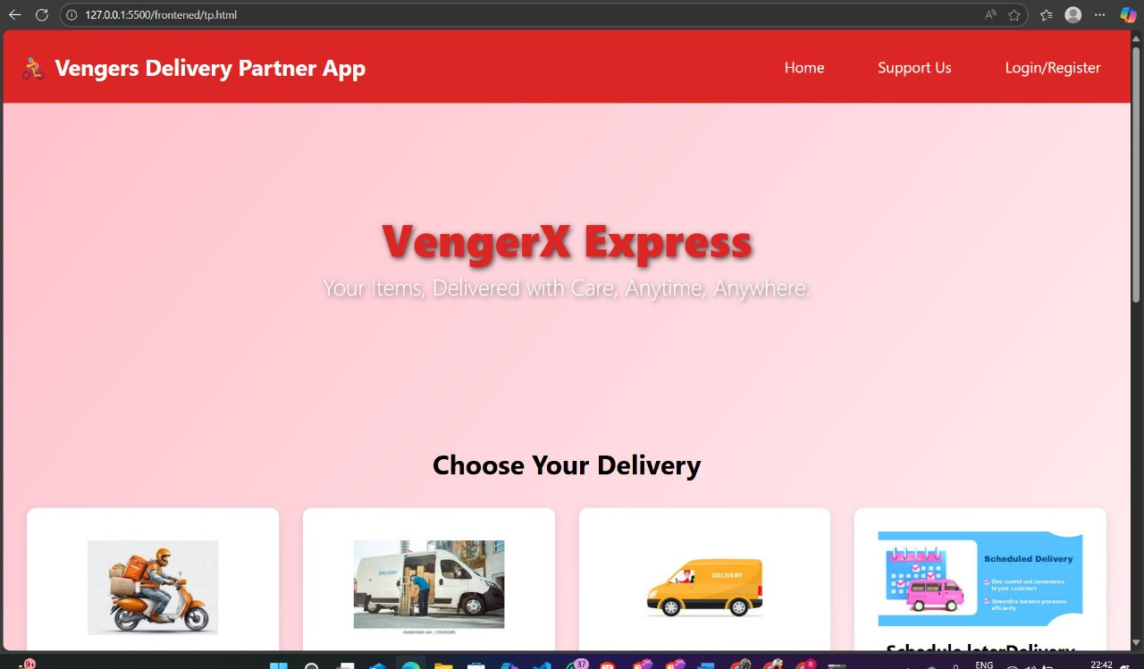
🔹 Highlights
✅ End-to-end delivery workflow (Book → Track → Proof of Delivery).
✅ Dual roles: Customer & Rider dashboards.
✅ AI Chatbot for FAQs & quick navigation.
✅ Clean, responsive design with progress bars, notifications & modals.
✅ Future-ready for backend integration (real DB, APIs, ML routing).
MAIN/LANDING DASHBOARD

Slide 5
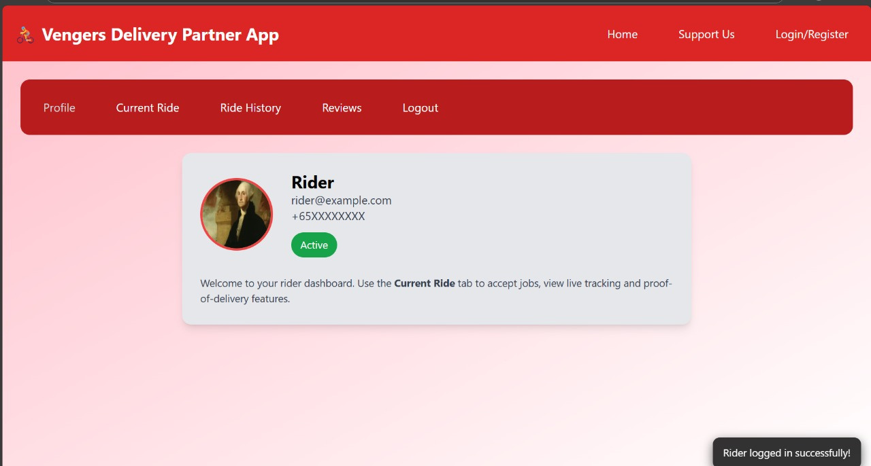
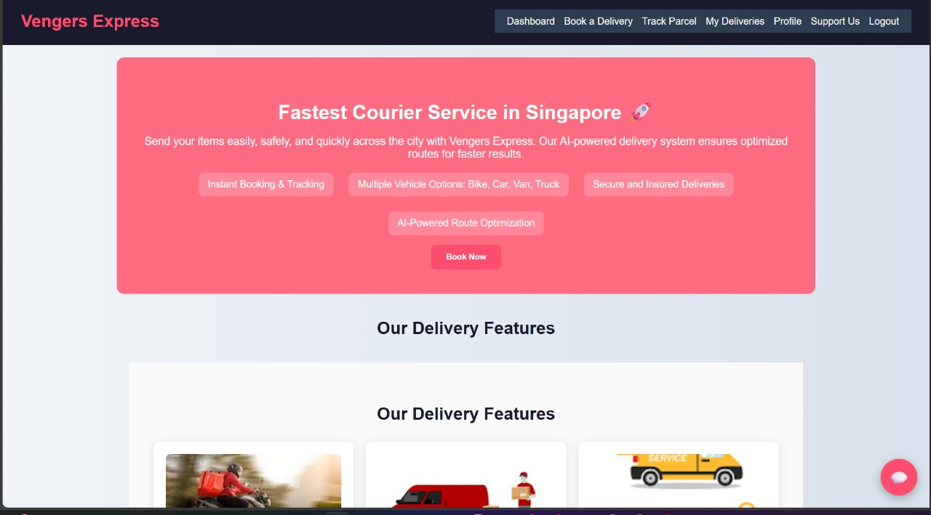
RIDER DASHBOARD
CUSTOMER DASHBOARD
GITHUB LINK: https://github.com/simrannair03/GrabHack
SUBMITTED BY:
CODE VENGERS
ADARSH JAIN
AKARSH JAIN
SIMRAN NAIR

